Slide 1
Lecture-1
Chapter-18
Temperature, Heat and The First Law of Thermodynamics
Thermodynamics: This is the study and application of the thermal energy.
Thermal Energy: This is the energy that comes from heat which is generated by the movement of the particles.
Temperature: Temperature is the measure of the average heat or thermal energy of the particles.
Unit: SI unit of temperature is K (Kelvin)

Slide 2


Other Scales of Temperature
Other popular temperature scales are Celsius scale and Fahrenheit scale.
The relation between the 3 scales are:
$$\frac{C}{5}=\frac{F−32}{9}=\frac{K−273.15}{5}$$
The relation between temperature differences in Celsius and Fahrenheit scales:
$$1^{0}C=\frac{9^{0}}{5} F$$

Slide 3

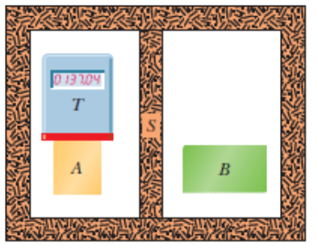
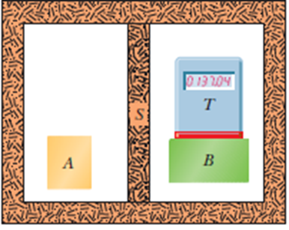
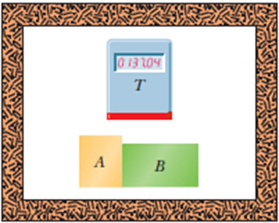
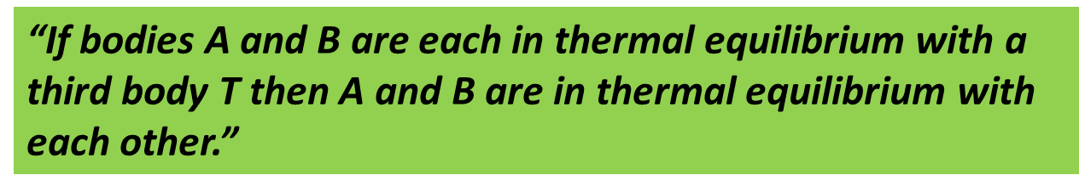

Slide 4
Absorption of Heats
Heat: Heat is the energy that is transferred between a system and its environment due to the temperature difference between them.
Heat is positive when energy is transferred to a system and negative transferred from the system.
Units of Heat:
1. Joule (J)
2. Calorie (cal)
3. British Thermal Unit (BTU)
The relations among the various heat units are:
1 cal=3.968×10⁻³ Btu = 4.1868 J.

Slide 5
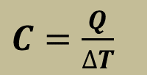
Absorption of Heat by Solid and Liquid
Heat Capacity: The amount of heat that is absorbed or lost by an object to change unit temperature is called the heat capacity of that object.
$C=\frac{Q}{∆T}$
Unit: cal/⁰C or cal/K or J/K.

Slide 6
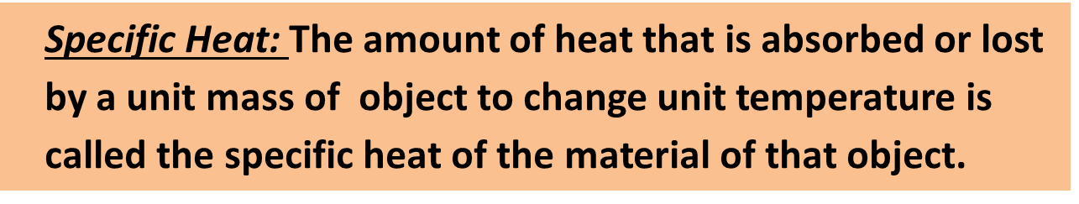
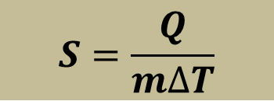


Molar Specific Heat: The amount of heat that is absorbed or lost by one mole of object to change unit temperature is called the molar specific heat of the material of that object.
$S=\frac{Q}{n∆T}$
Unit: J/mol.K

Slide 7










Problem 22 : A small electric immersion heater is used to heat 100 g of water for a cup of instant coffee. The heater is labeled “200 watts” (it converts electrical energy to thermal energy at this rate). Calculate the time required to bring all this water from 23° C to 100° C, ignoring any heat losses.
Given$, m=0.1 Kg$
$$P=\frac{Q}{t}$$
$$S=\frac{Q}{m∆T}$$
$S=4200$J/Kg-K
$$⇒Q=mS∆T$$
$$⇒t=\frac{Q}{P}=161.7 sec$$
$$T_{i}={23}^{0}C=296 K$$
$$T_{f}={100}^{0}C=373 K$$
$$⇒Q=32340 J$$
$$P=200 watt$$

Slide 8




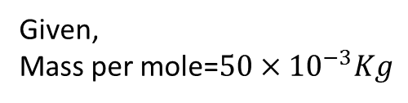






Problem 24 : A certain substance has a mass per mole of 50.0 g/mol. When 314 J is added as heat to a 30.0 g sample, the sample’s temperature rises from 25.0° C to 45.0° C. What are the (a) specific heat and (b) molar specific heat of this substance? (c) How many moles are in the sample?
Given,
Mass per mole=$50×{10}^{−3}Kg$
$\left(a\right) S=\frac{Q}{m∆T}=523.33$J/Kg-K
$S=\frac{Q}{n∆T}=26.17$J/mole-K
$$Mass, m=30×{10}^{−3}Kg$$
$$\left(b\right) n=\frac{m}{mass per mole}$$
$$\left(c\right)n=0.6 mole$$
$$T_{i}={25}^{0}C=298 K$$
$$T_{f}={45}^{0}C=318 K$$
$$=\frac{30×{10}^{−3}}{50×{10}^{−3}}$$
$$Q=314 J$$
$$=0.6$$

